Slide 1
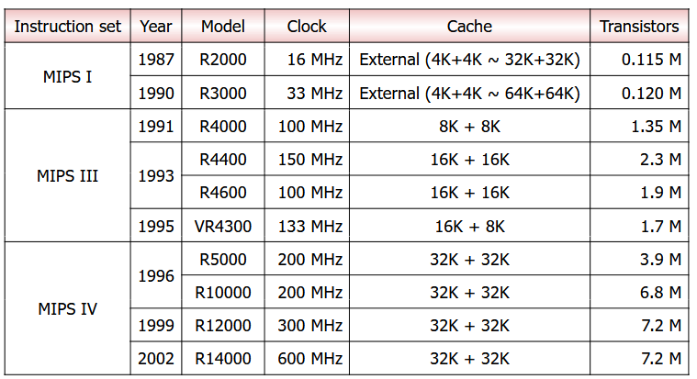
MIPS architecture
&
Instruction Set

Slide 2

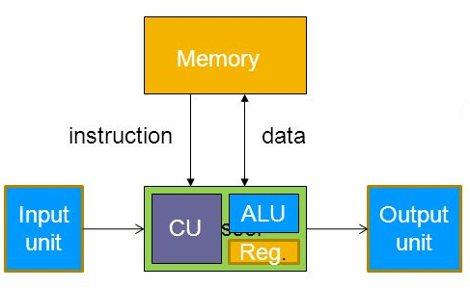

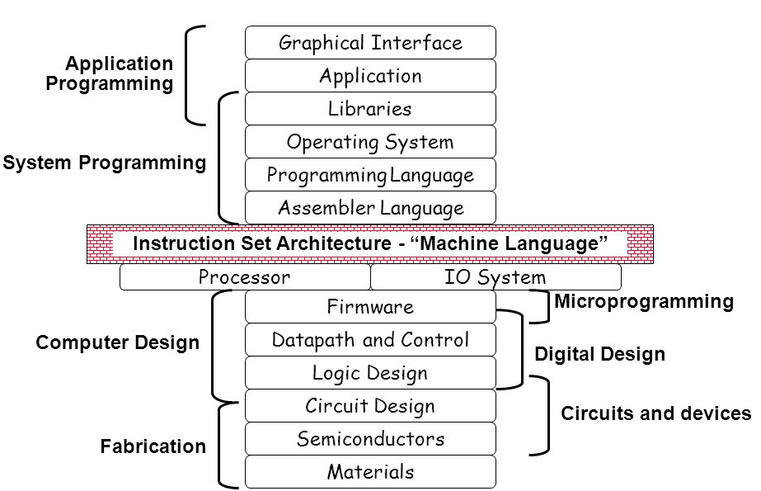

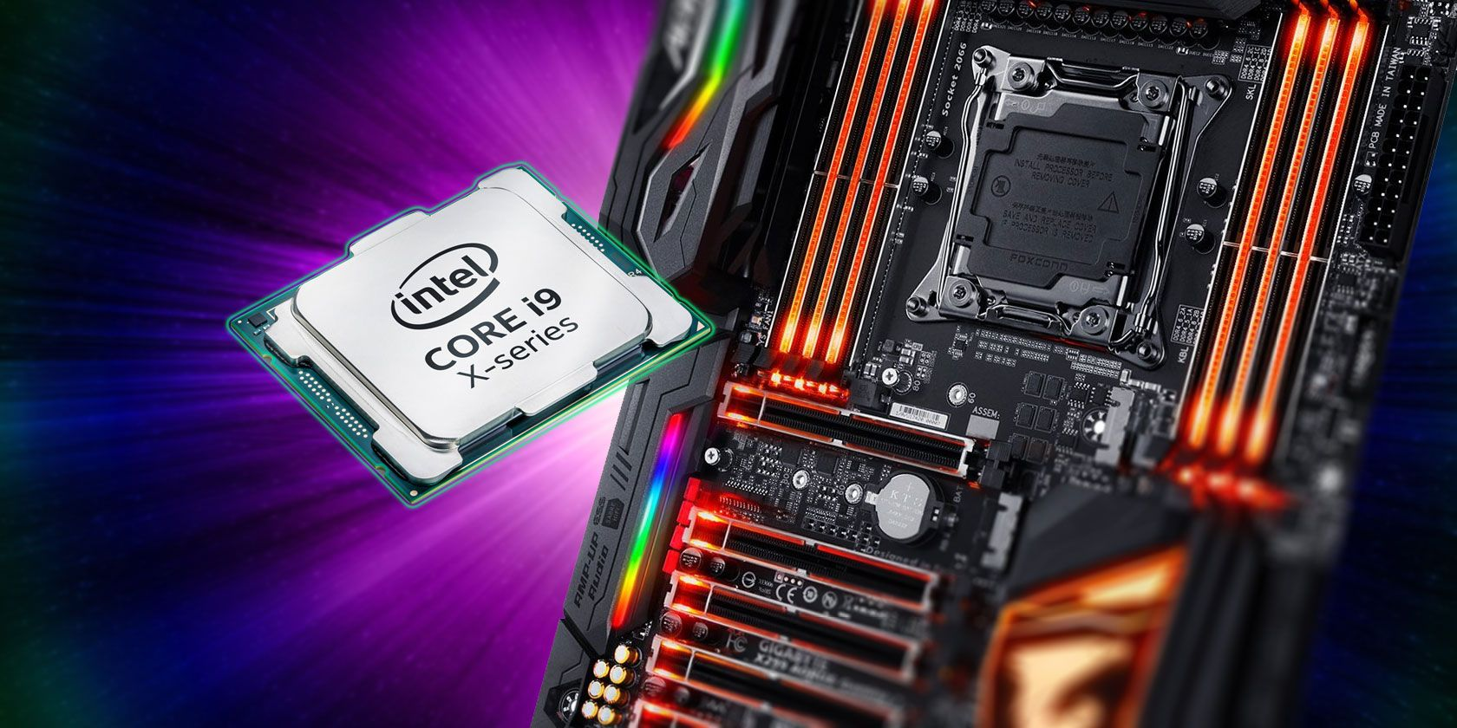

Slide 3
Instruction Set Architecture
The instruction set provides commands to the processor, to tell it what it needs to do.
The instruction set consists of addressing modes, instructions, data types, registers, memory architecture, I/O mechanisms etc.
The processor's architecture and instruction set determine how many cycles, or ticks, are needed to execute a given instruction.
Different computers have different instruction sets
But with many aspects in common
Early computers had very simple instruction sets
Simplified implementation
Many modern computers also have simple instruction set.

Slide 4
Classification of ISA
An ISA may be classified in a number of different ways. A common classification is by architectural complexity.
Complex instruction set computer (CISC) has many specialized instructions, some of which may only be rarely used in practical programs.
Reduced instruction set computer (RISC) simplifies the processor by efficiently implementing only the instructions that are frequently used in programs, while the less common operations are implemented as subroutines, having their resulting additional processor execution time offset by infrequent use.
Very long instruction word (VLIW) architectures, and the closely related long instruction word (LIW) and explicitly parallel instruction computing (EPIC) architectures. These architectures seek to exploit instruction-level parallelism with less hardware than RISC and CISC by making the compiler responsible for instruction issue and scheduling.

Slide 5
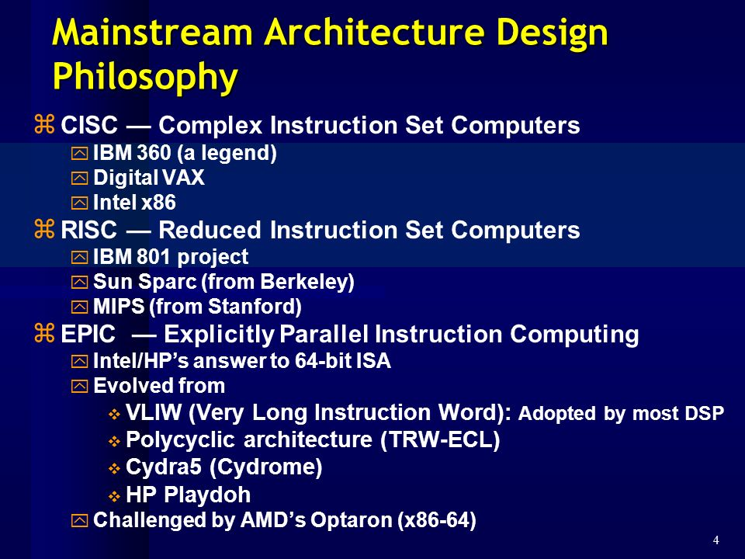

Slide 6
Mainstream ISAs
Intel 80x86
Used in Macbooks and PCs
Found in Core i3, Core i5, Core i7, etc.
Advanced RISC Machine (ARM)
Smart phone-like devices: iPhone, iPad, iPod, etc.
The most popular RISC (20x more common than 80x86)
MIPS
Networking equipment, PS2, PSP
Very similar to ARM
Notes:
MIPS was originally an acronym for Microprocessor without Interlocked Pipeline Stages. Developed by MIPS Technologies (formerly MIPS Computer Systems, Inc.).

Slide 7
Background of RISC
IBM RISC technology originated in 1974 in a project to design a large telephone-switching network capable of handing an average of three hundred calls per second. With an approximate 20 000 instructions per call and Stringent real-time response requirements, the performance target was 12 million instructions per second (MIPS).
This specialized application required a very fast processor, but did not have to perform computed instructions and had little demand for floating-point calculations. Other than moving data between registers and memory, the machine had to be able to add, combine fields extracted from several registers, perform branches, and carry out input/output operations.

Slide 8
Background of RISC
When the telephone project was terminated in 1975, the machine itself had not been built, but the design had progressed to the point where it seemed to be an excellent basis for a general-purpose, high-performance miniprocessor. The attractiveness of the processor design stemmed from projections that it would be able to compute at high speed relative to its cost in a variety of application areas.
The most important features of the telephone switching machine which contributed to its low cost/performance ratio were 1) separate instruction and data caches, allowing a much higher bandwidth between memory and CPU; 2) no arithmetic operations to storage, which greatly simplified the pipeline; and 3) uniform instruction length and simplicity of design, making possible a very short cycle time: ten levels of logic. (For example, all register-to-register operations executed in one cycle.)

Slide 9
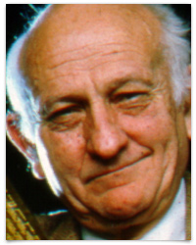


Background of RISC
John Cocke and his colleagues developed simpler ISAs and compilers for minicomputers. As an experiment, they retargeted their research compilers to use only the simple register-register operations and load-store data transfers of the IBM 360 ISA, avoiding the more complicated instructions. They found that programs ran up to three times faster using the simple subset.
Emer and Clark found 20% of the VAX instructions needed 60% of the microcode and represented only 0.2% of the execution time.

Slide 10
RISC: Reduced Instruction Set Computer
A type of microprocessor architecture that utilizes a small, highly-optimized set of instructions
History: The first RISC projects came from IBM, Stanford, and UC-Berkeley in the late 70s and early 80s. The IBM 801, Stanford MIPS, and Berkeley RISC 1 and 2 were all designed with a similar philosophy.
Design features of RISC processors:
one cycle execution time: RISC processors have a CPI (clock per instruction) of one cycle. This is due to the optimization of each instruction on the CPU and a technique called pipelining;
pipelining: a technique that allows for simultaneous execution of parts, or stages, of instructions to more efficiently process instructions;
large number of registers: RISC design philosophy generally incorporates a larger number of registers to prevent in large amounts of interactions with memory

Slide 11
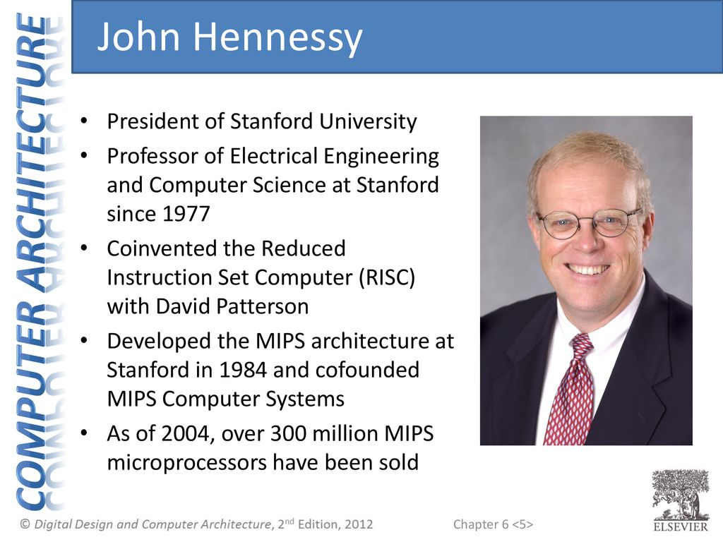
MIPS
The MIPS processor was developed as part of a VLSI research program at Stanford University in the early 80s.
Professor John Hennessy started the development of MIPS with a brainstorming class for graduate students. The readings and idea sessions helped launch the development of the processor which became one of the first RISC processors, with IBM and Berkeley developing processors at around the same time.

Slide 12
MIPS Architecture
The Stanford research group had a strong background in compilers, which led them to develop a processor whose architecture would represent the lowering of the compiler to the hardware level, as opposed to the raising of hardware to the software level, which had been a long running design philosophy in the hardware industry.
Thus, the MIPS processor implemented a smaller, simpler instruction set. Each of the instructions included in the chip design ran in a single clock cycle. The processor used a technique called pipelining to more efficiently process instructions.
MIPS used 32 registers, each 32 bits wide (a bit pattern of this size is referred to as a word).

Slide 13
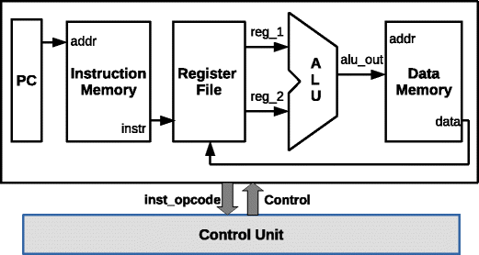
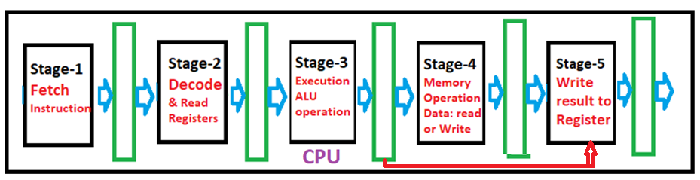
Instruction cycle of MIPS processor was subdivided into five stages:
Instruction Fetch (IF)
Instruction Decode (ID) and Register Read
Execution (EXE)
Memory read/write(MEM)
Write Back result (WB) to Registers

Slide 14
How Pipelining Works
Pipelining, a standard feature in RISC processors, is much like an assembly line. Because the processor works on different steps of the instruction at the same time, more instructions can be executed in a shorter period of time.
CPI = 1
Instruction\ clock cycles | 1 | 2 | 3 | 4 | 5 | 6 | 7 | 8
Instruction-1 | IF | ID | EX | MA | WB
Instruction-2 |  | IF | ID | EX | MA | WB
Instruction-3 |  |  | IF | ID | EX | MA | WB
Instruction-4 |  |  |  | IF | ID | EX | MA
Instruction-5 |  |  |  |  | IF | ID | EX
Instruction-6 |  |  |  |  |  | IF | ID
Instruction-7 |  |  |  |  |  |  | IF
Non-pipelined processor (CPI = 5)
Instruction/Clock cycles | 1 | 2 | 3 | 4 | 5 | 6 | 7 | 8 | 9 | 10 | 11 | 12 | 13 | 14 | 15
Instruction-1 | IF | ID | EX | MEM | WB
Instruction-2 |  |  |  |  |  | IF | ID | EX | MEM | WB
Instruction-3 |  |  |  |  |  |  |  |  |  |  | IF | ID | EX | MEM | WB

Slide 15
Common RISC Simplifications
Fixed instruction length: Simplifies fetching instructions from memory
Simplified addressing modes: Simplifies fetching operands from memory
Few and simple instructions in the instruction set: Simplifies instruction execution
Minimize memory access instructions (load/store): Simplifies necessary hardware for memory access
Let compiler do heavy lifting: Breaks complex statements into multiple assembly instructions

Slide 16
MIPS (Microprocessor without Interlocked Pipeline Stages)
MIPS, an acronym for Microprocessor without Interlocked Pipeline Stages, was a research project conducted by John L. Hennessy at Stanford University between 1981 and 1984.
MIPS is a reduced instruction set computer (RISC) instruction set architecture (ISA)
In 1985, MIPS Computer Systems (now MIPS Technologies, based in the United States) announced a new instruction set architecture (ISA) also called MIPS, and its first implementation, the R2000 microprocessor.
The R2000 is a 32-bit microprocessor chip set that implemented the MIPS I instruction set architecture (ISA).
A fixed-length, regularly encoded instruction set and uses a load/store data model –Used by NEC, Cisco, Silicon Graphics, Sony, Nintendo.
R2000 was used in the DEC station 2100 and DEC station 3100 as well as several others.

Slide 17
The instruction set consists of about 111 total instructions. A variety of basic instructions, including:
21 arithmetic instructions (+, -, *, /, %)
8 logic instructions (&, |, ~)
8 bit manipulation instructions
12 comparison instructions (>, <, =, >=, <=, ¬)
25 branch/jump instructions
15 load instructions
10 store instructions
8 move instructions
4 miscellaneous instructions

Slide 18
Instruction cycle of MIPS processor was subdivided into five stages:
Instruction Fetch (IF)
Instruction Decode (ID) and Register Read
Execution (EXE)
Memory read/write(MEM)
Write Back result (WB) to Registers

Slide 19
Instruction Execution
PC → instruction memory, fetch instruction
Register numbers → register file, read registers
Depending on instruction class
Use ALU to calculate
Arithmetic result
Memory address for load/store
Branch target address
Access data memory for load/store
PC ← target address or PC + 4

Slide 20
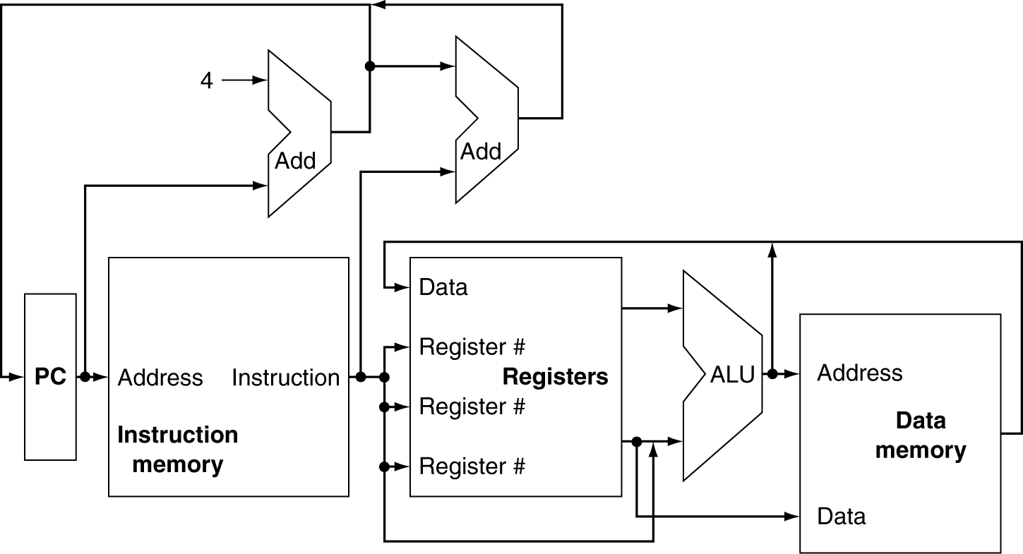
CPU Overview

Slide 21
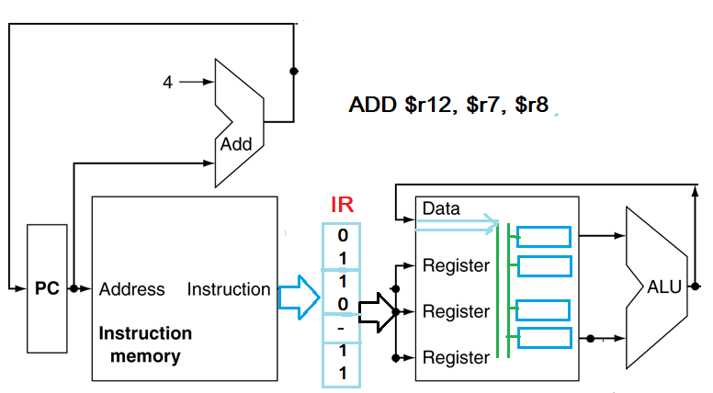

Slide 22
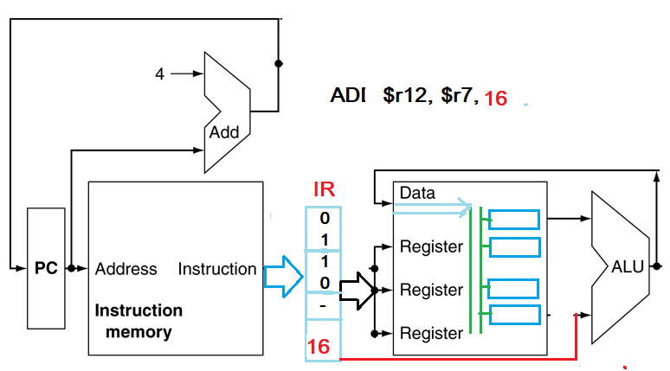

Slide 23
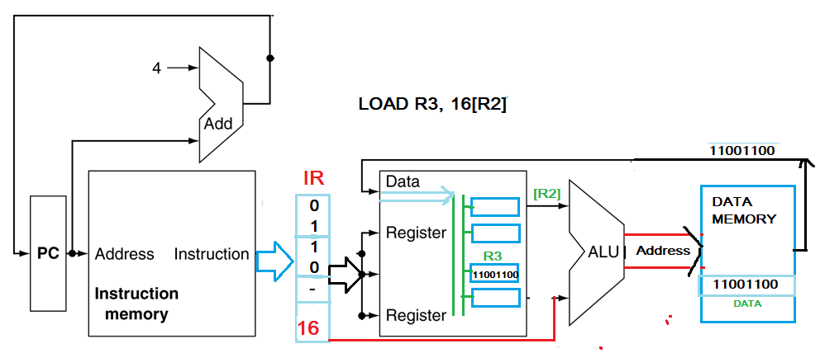

Slide 24
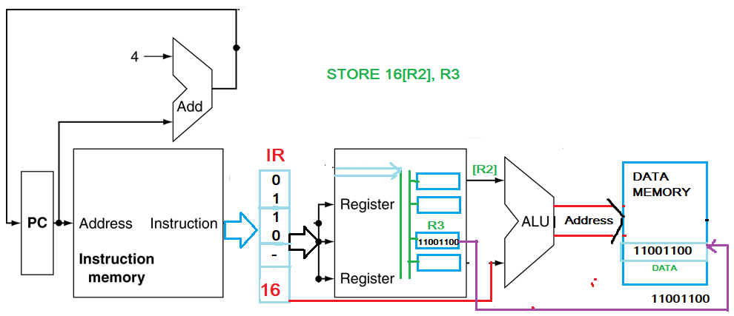

Slide 25
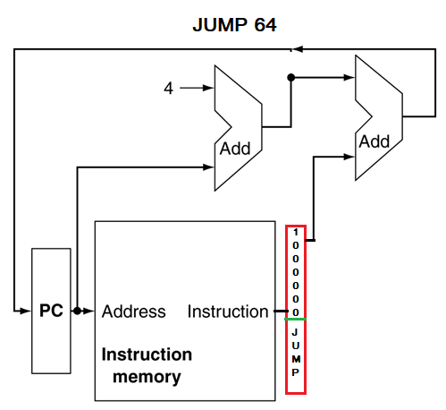

Slide 26
CPU Overview

Slide 27
Multiplexers
Can’t just join wires together
Use multiplexers

Slide 28
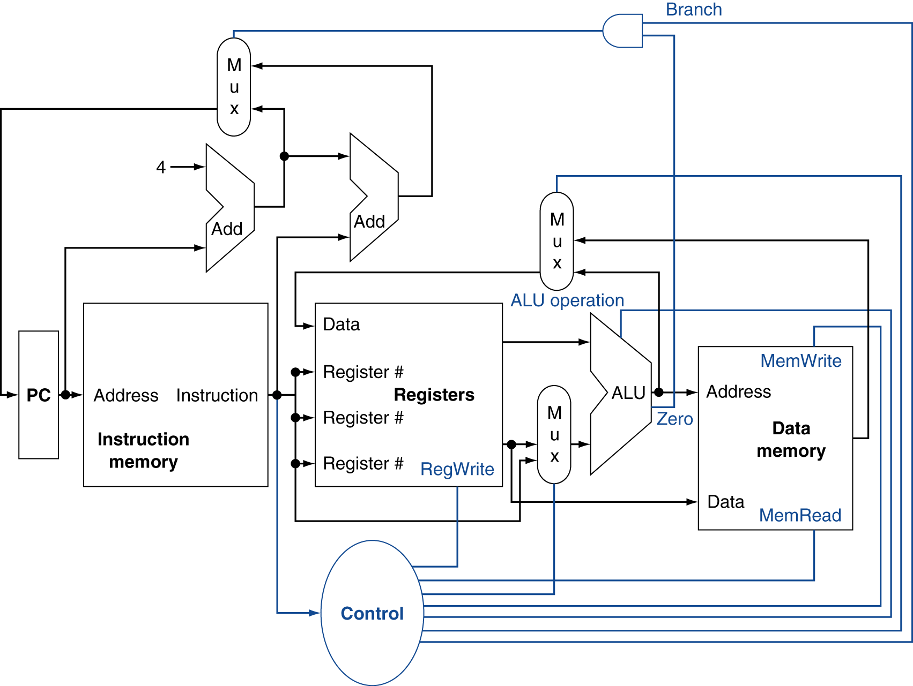
Control

Slide 29
Computer Hardware Operands
In high-level languages, number of variables limited only by available memory
ISAs have a fixed, small number of operands called registers
Special locations built directly into hardware
Benefit: Registers are EXTREMELY FAST (faster than 1 billionth of a second)
Drawback: Operations can only be performed on these predetermined number of registers
Notes:
Registers visible to compiler (or MIPS programmer).

Slide 30
MIPS Registers
MIPS has 32 registers
Each register is 32 bits wide and holds a word
Tradeoff between speed and availability
Smaller number means faster hardware but insufficient to hold data for typical C programs
Registers have no type (C concept); the operation being performed determines how register contents are treated
Notes:
word = group of 32 bits (like how byte = group of 8 bits)
For the sake of comparison, ARM uses 16 registers.

Slide 31
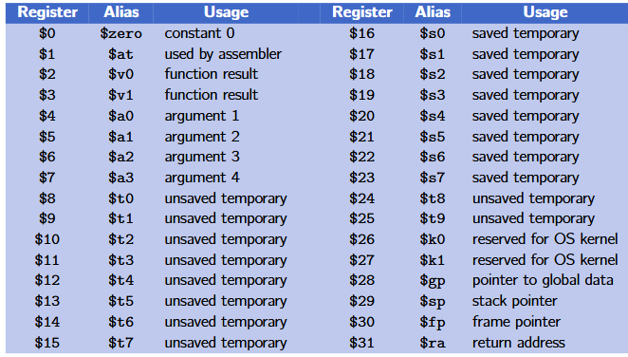
MIPS Registers

Slide 32
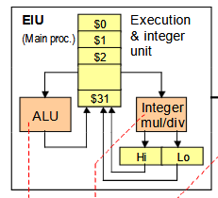
MIPS

Slide 34
MIPS Registers
Register denoted by ‘$’ can be referenced by number ($0-$31) or name:
Registers that hold programmer variables:
$s0-$s7 $16-$23
Registers that hold temporary variables:
$t0-$t7 $8-$15
$t8-$t9 $24-$25
You’ll learn about the other 14 registers later
In general, using register names makes code more readable
Notes:
Both the book and the a quick Google search do not provide a sufficient explanation for why $t8 and $t9 are separated from the other temporary registers.

Slide 35
Register Operands
Arithmetic instructions use register operands
MIPS has a 32 × 32-bit register file
Use for frequently accessed data
Numbered 0 to 31
32-bit data called a “word”
Assembler names
$t0, $t1, …, $t7 for temporary values
$s0, $s1, …, $s7 for saved variables

Slide 36
In MIPS assembly language
$s0 - $s7 maps onto register 16 to 23
$t0 - $t7 maps onto register 8 to 15
$s0 means register 16
$s1 means register 17
…….
$t0 means register 8
$t1 means register 9
……..

Slide 37
Memory Operands
Main memory used for composite data
Arrays, structures, dynamic data
To apply arithmetic operations
Load values from memory into registers
Store result from register to memory
Memory is byte addressed
Each address identifies an 8-bit byte
Words are aligned in memory
Address must be a multiple of 4
MIPS is Big Endian
Most-significant byte at least address of a word
Big here means the largest address, the least significant byte at the largest address. Byte address 0 1 2 3. The MSB at address 0 the LSB at address 3
Little Endian:
least-significant byte at least address
Little here means the least address. The least significant byte at the least address. Byte Address 0 1 2 3. MSB at address 3, the LSB at address 0

Slide 38
MIPS Instructions
One operation per instruction, at most one instruction per line
Assembly instructions are related to C operations (=, +, -, *, /, &, |, etc.)
Must be, since C code decomposes into assembly!
A single line of C may break up into several lines of MIPS

Slide 39
MIPS Instructions
Instruction Syntax is rigid:
add $s1, $s2, $s3
op dst, src1, src2
1 operator, 3 operands
op = operation name (“operator”)
dst = register getting result (“destination”)
src1 = first register for operation (“source 1”)
src2 = second register for operation (“source 2”)

Slide 40
MIPS Instructions
Instruction Syntax :
op dst, src1, src2
op = operation name (“operator”)
dst = register getting result (“destination”)
src1 = first register for operation (“source 1”)
src2 = second register for operation (“source 2”)
Integer Addition (add)
C: a = b + c
MIPS: add $s1, $s2, $s3
Integer Subtraction (sub)
C: a = b - c
MIPS: sub $s1, $s2, $s3

Slide 41
MIPS Instructions Example
Suppose a=$s0,
b=$s1,
c=$s2,
d=$s3, and
e=$s4.
Convert the following C statement to MIPS:
a = (b + c) – (d + e);
add $t1, $s3, $s4
add $t2, $s1, $s2
sub $s0, $t2, $t1
Ordering of instructions matters (must follow order of operations)
Notes:
add $so, $s1, $s2
add $t0, $s3, $s4
sub $s0, $s0, $t0

Slide 42
Comments in MIPS
Comments in MIPS follow hash mark (#) until the end of line
Improves readability and helps you keep track of variables/registers!
add $t1, $s3, $s4 # $t1=d+e
add $t2, $s1, $s2 # $t2=b+c
sub $s0, $t2, $t1 # a=(b+c)-(d+e)

Slide 43
The Zero Register
Zero appears so often in code and is so useful that it has its own register!
Register zero ($0 or $zero) always has the value 0 and cannot be changed!
i.e. any instruction with $0 as dst has no effect
Example Uses:
add $s3, $0, $0 # c=0
add $s1, $s2, $0 # a=b

Slide 44
Immediates
Numerical constants are called immediates
Separate instruction syntax for immediates:
opi dst, src, imm
Operation names end with ‘i’, replace 2nd source register with an immediate
Example Uses:
addi $s1, $s2, 5 # a=b+5
addi $s3, $s3, 1 # c++
Notes:
Goal of RISC is to minimize instruction set. subi dst, src, imm = addi dst, src, -imm.

Slide 45
Data Transfer
Store: register to memory
Load: register from memory
Load Word
Reads data FROM memory and places it into reg
Store Word
Saves contents of a reg and stores it to memory

Slide 46
Data Transfer
Instruction syntax for data transfer between
Register and Memory
op reg, off(bAddr)
op = operation name (“operator”)
reg = register for operation source or destination
bAddr = register with pointer to memory (“base address”)
off = address offset (immediate) in bytes (“offset”)
Accesses memory at address bAddr+off
Load Word: lw $t0,12($s3)
Takes data at address bAddr+off FROM memory and places it into reg
Store Word: sw $t0,40($s3)
Takes data in reg and stores it TO memory at address bAddr+off

Slide 47
Endianness
Big Endian: Most-significant byte at least address of word
word address = address of most significant byte
Little Endian: Least-significant byte at least address of word
word address = address of least significant byte
MIPS is bi-endian (can go either way)
Using MARS simulator in lab, which is little endian
Why is this confusing?
Data stored in reverse order than you write it out!
Data 0x01020304 stored as 04 03 02 01 in memory
3 2 1 0
little endian
msb
lsb
big endian
0 1 2 3
Increasing address

Slide 48
Data Transfer Instructions
Load Word (lw)
Takes data at address bAddr+off FROM memory and places it into reg
Store Word (sw)
Takes data in reg and stores it TO memory at address bAddr+off
Example Usage:
# addr of int A[] -> $s3, a -> $s0
lw $t0,12($s3) # $t0=A[3]
add $t0,$s2,$t0 # $t0=A[3]+a
sw $t0,40($s3) # A[10]=A[3]+a

Slide 49
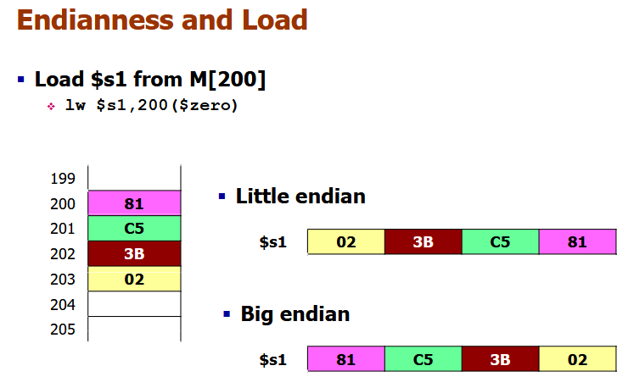

Slide 50
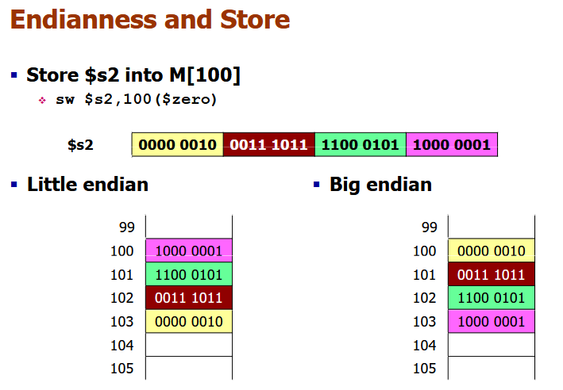

Slide 51
Decision Making Instructions
Branch If Equal (beq)
beq reg1,reg2,label
If value in reg1 = value in reg2, go to label
Branch If Not Equal (bne)
bne reg1,reg2,label
If value in reg1 ≠ value in reg2, go to label
Jump (j)
j label
Unconditional jump to label

Slide 52
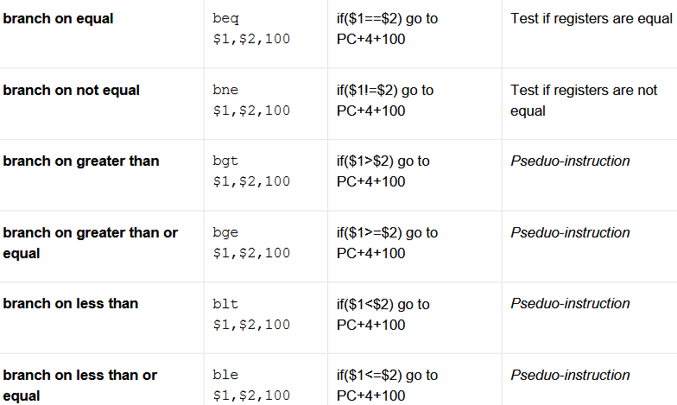

Slide 53
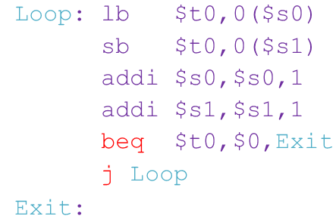
beq reg1,reg2,label j label

Slide 54
Summary
Computers understand the instructions of their ISA
RISC Design Principles
Smaller is faster, keep it simple
MIPS Registers: $s0-$s7, $t0-$t9, $0
MIPS Instructions
Arithmetic: add, sub, addi
Data Transfer: lw, sw, lb, sb, lbu
Branching: beq, bne, j
Memory is byte-addressed

Slide 55
C to MIPS Practice
Let’s put our all of our new MIPS knowledge to use in an example: “Fast String Copy”
C code is as follows:
/* Copy string from p to q */
char *p, *q;
while((*q++ = *p++) != ‘\0’) ;
What do we know about its structure?
Single while loop
Exit condition is an equality test

Slide 56
C to MIPS Practice
Start with code skeleton:
# copy String p to q
# p→$s0, q→$s1 (pointers)
Loop: lb $t0,0($s0) # $t0 = *p
sb $t0,0($s1) # *q = $t0
addi $s0,$s0,1 # p = p + 1
addi $s1,$s1,1 # q = q + 1
beq $t0,$0,Exit # if *p==0, go to Exit
j Loop # go to Loop
Exit: # N chars in p => N*6 instructions
# $t0 = *p
# *q = $t0
# p = p + 1
# q = q + 1
# if *p==0, go to Exit
# go to Loop

Slide 57
C to MIPS Practice
Fill in lines:
# copy String p to q
# p→$s0, q→$s1 (pointers)
Loop: lb $t0,0($s0) # $t0 = *p
sb $t0,0($s1) # *q = $t0
addi $s0,$s0,1 # p = p + 1
addi $s1,$s1,1 # q = q + 1
beq $t0,$0,Exit # if *p==0, go to Exit
j Loop # go to Loop
Exit: # N chars in p => N*6 instructions
lb $t0,0($s0)
sb $t0,0($s1)
addi $s0,$s0,1
addi $s1,$s1,1
beq $t0,$0,Exit

Slide 58
C to MIPS Practice
Finished code:
# copy String p to q
# p→$s0, q→$s1 (pointers)
Loop: lb $t0,0($s0) # $t0 = *p
sb $t0,0($s1) # *q = $t0
addi $s0,$s0,1 # p = p + 1
addi $s1,$s1,1 # q = q + 1
beq $t0,$0,Exit # if *p==0, go to Exit
j Loop # go to Loop
Exit: # N chars in p => N*6 instructions
Notes:
Is this the only way to write out this function? Of course not.

Slide 59
C to MIPS Practice
Alternate code using bne:
# copy String p to q
# p→$s0, q→$s1 (pointers)
Loop: lb $t0,0($s0) # $t0 = *p
sb $t0,0($s1) # *q = $t0
addi $s0,$s0,1 # p = p + 1
addi $s1,$s1,1 # q = q + 1
bne $t0,$0,Loop # if *p!=0, go to Loop
# N chars in p => N*5 instructions
Notes:
Used fewer instructions!
Instead of “exit when equal to zero”, we are now using “loop when not equal to zero.”

Slide 60
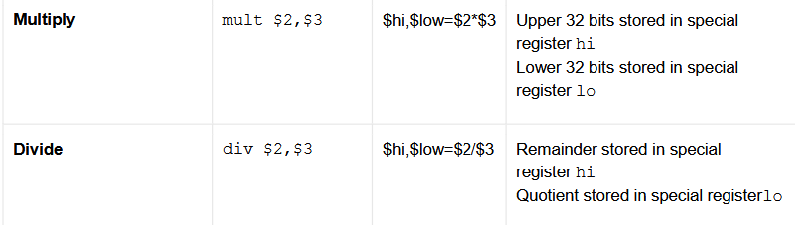

Slide 61

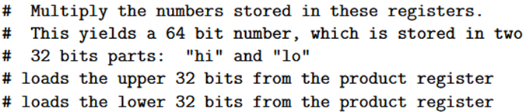
MIPS Arithmetic Instructions: Multiplication

Slide 62


MIPS Arithmetic Instructions: Division

Slide 63
MIPS Bitwise Instructions
Note: a→$s1, b→$s2, c→$s3
Instruction | C | MIPS
And | a = b & c; | and $s1,$s2,$s3
And Immediate | a = b & 0x1; | andi $s1,$s2,0x1
Or | a = b | c; | or $s1,$s2,$s3
Or Immediate | a = b | 0x5; | ori $s1,$s2,0x5
Not Or | a = ~(b | c); | nor $s1,$s2,$s3
Exclusive Or | a = b ^ c; | xor $s1,$s2,$s3
Exclusive Or Immediate | a = b ^ 0xF; | xori $s1,$s2,0xF

Slide 64
Shifting Instructions
In binary, shifting an unsigned number left is the same as multiplying by the corresponding power of 2
Shifting operations are faster
Does not work with shifting right/division
Logical shift: Add zeros as you shift
Arithmetic shift: Sign-extend as you shift
Only applies when you shift right (preserves sign)
Can shift by immediate or value in a register

Slide 65
Shifting Instructions
Instruction Name | MIPS
Shift Left Logical | sll $s1,$s2,1
Shift Left Logical Variable | sllv $s1,$s2,$s3
Shift Right Logical | srl $s1,$s2,2
Shift Right Logical Variable | srlv $s1,$s2,$s3
Shift Right Arithmetic | sra $s1,$s2,3
Shift Right Arithmetic Variable | srav $s1,$s2,$s3
When using immediate, only values 0-31 are accepted
When using variable, only lowest 5 bits are used (read as unsigned)

Slide 66
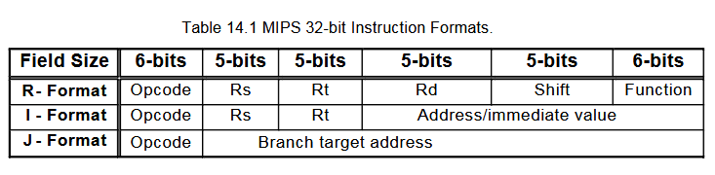
Machine Code Instructions in Binary bits Instructions in Numbers 32 bits in binary 8-digits in hexcode 0x12A6012C

Slide 67
Instruction Formats
I-Format: instructions with immediates, lw/sw (offset is immediate), and beq/bne
J-Format: j and jal
R-Format: all other instructions
Instruction fields
op: operation code (opcode)
Rs: first source register number
Rt: second source register number
Rd: destination register number
Shift: shift amount (00000 for now)
Function: function code (extends opcode)

Slide 68
Instructions as Numbers
Divide the 32 bits of an instruction into “fields”
Each field tells the processor something about the instruction
Could use different fields for every instruction, but regularity leads to simplicity
Define 3 types of instruction formats:
R-Format
I-Format
J-Format

Slide 69
Instruction Formats
I-Format: instructions with immediates, lw/sw (offset is immediate), and beq/bne
J-Format: j and jal
R-Format: all other instructions
Instruction fields
op: operation code (opcode)
Rs: first source register number
Rt: second source register number
Rd: destination register number
Shift: shift amount (00000 for now)
Function: function code (extends opcode)

Slide 70
MIPS R-format Instructions
op
rs
rt
rd
shamt
funct
6 bits
5 bits
5 bits
5 bits
5 bits
6 bits
Instruction fields
op: operation code (opcode)
rs: first source register number
rt: second source register number
rd: destination register number
shamt: shift amount (00000 for now)
funct: function code (extends opcode)

Slide 71
R-format Example
op
rs
rt
rd
shamt
funct
6 bits
5 bits
5 bits
5 bits
5 bits
6 bits
add $t0, $s1, $s2
special
$s1
$s2
$t0
0
add
0
17
18
8
0
32
000000
10001
10010
01000
00000
100000
00000010001100100100000000100000₂ = 0x02324020

Slide 72
R-Format Instructions
Define “fields” of the following number of bits each: 6 + 5 + 5 + 5 + 5 + 6 = 32
Each field has a name:
Each field is viewed as its own unsigned int
5-bit fields can represent any number 0-31, while 6-bit fields can represent any number 0-63
31
0
6
5
5
5
5
6
31
0
opcode
rs
rt
rd
shamt
funct

Slide 73
R-Format Instructions
opcode (6): partially specifies operation
Set at 0b000000 for all R-Format instructions
funct (6): combined with opcode, this number exactly specifies the instruction
rs (5): specifies register containing 1st operand (“source register”)
rt (5): specifies register containing 2nd operand (“target register” – name is misleading)
rd (5): specifies register that receives the result of the computation (“destination register”)
shamt (5): The amount a shift instruction will shift by
Shifting a 32-bit word by more than 31 is useless
This field is set to 0 in all but the shift instructions

Slide 74
R-Format Example
31
0
opcode
rs
rt
rd
shamt
funct
MIPS Instruction: add $8,$9,$10
Field representation (decimal):
Field representation (binary):
hex representation: 0x 012A 4020
decimal representation: 19,546,144
Called a Machine Language Instruction
31
0
0
9
10
8
0
32
31
0
000000
01001
01010
01000
00000
100000
_{two}
Notes:
$8 = $t0, $9 = $t1, $10 = $t2

Slide 75
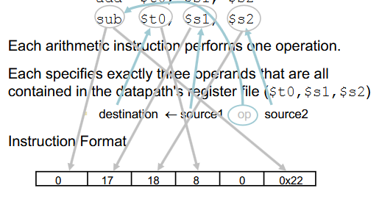

Slide 76
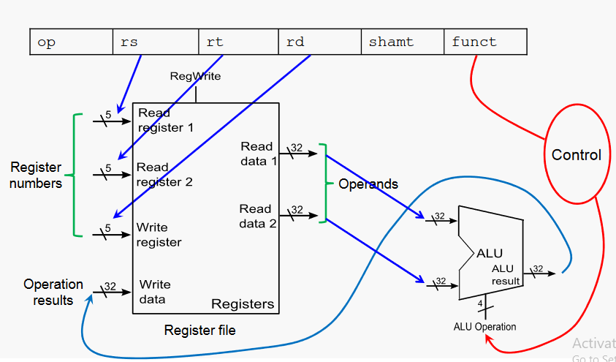
R-format Instruction

Slide 77
MIPS I-format Instructions
op
rs
rt
constant or address
6 bits
5 bits
5 bits
16 bits
Immediate arithmetic: addi $s1,$s2,16
Load: lw $t0,12($s3)
Store: sw $t0,40($s3)
rt: destination or source register number
Constant/offset: –2¹⁵ to +2¹⁵ – 1
rs: first source register in ALU instruction
Base register in load/store instruction
Address: offset added to base address in rs

Slide 78
I-Format Instructions
Define “fields” of the following number of bits each: 6 + 5 + 5 + 16 = 32 bits
Field names:
Key Concept: Three fields are consistent with R-Format instructions
Most importantly, opcode is still in same location
31
0
6
5
5
16
31
0
opcode
rs
rt
immediate

Slide 79
I-Format Example
MIPS Instruction: addi $21,$22,-50
Field representation (decimal):
Field representation (binary):
hex representation: 0x 22D5 FFCE
decimal representation: 584,449,998
Called a Machine Language Instruction
31
0
8
22
21
-50
31
0
001000
10110
10101
1111111111001110
_{two}
Notes:
$21 = $s5, $22 = $s6

Slide 80
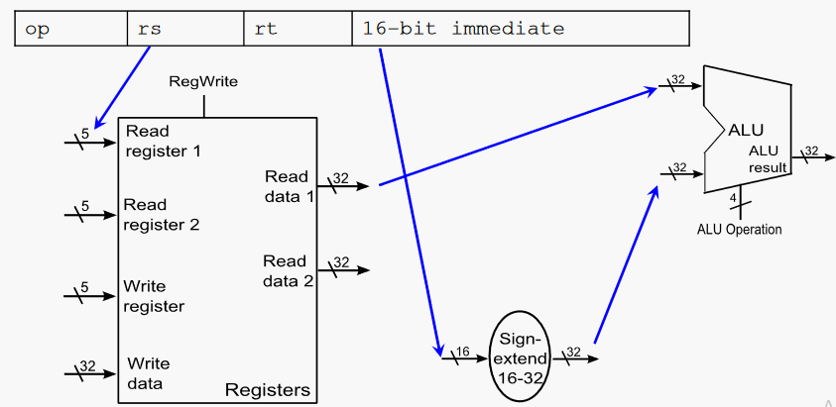
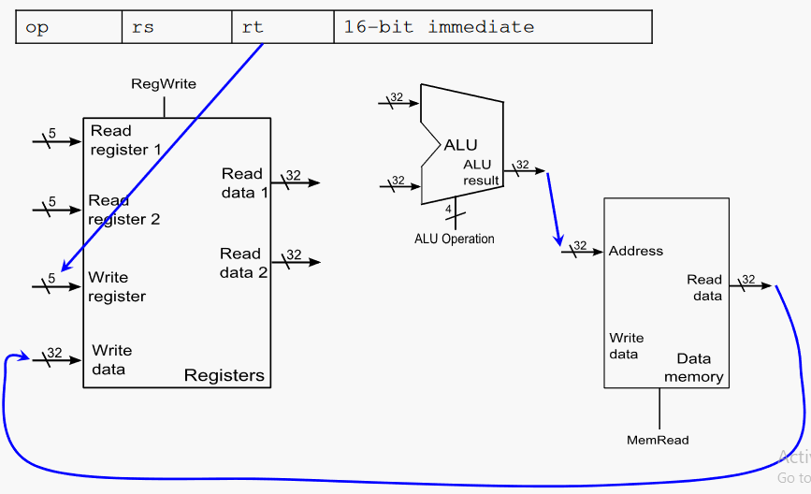
Load Instruction lw $t0,0($t1)

Slide 81


Slide 82
Branching Instructions
beq and bne
Need to specify an address to go to
Also take two registers to compare
Use I-Format:
opcode specifies beq (4) vs. bne (5)
rs and rt specify registers
How to best use immediate to specify addresses?
31
0
opcode
rs
rt
immediate

Slide 83
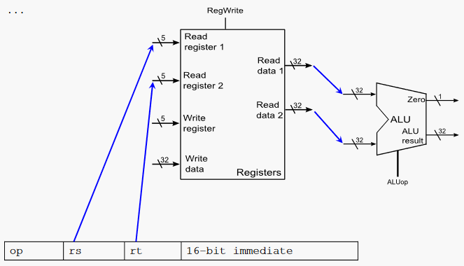
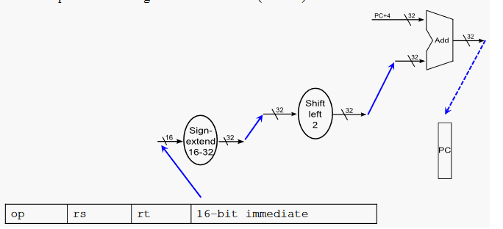

Slide 84
J-Format Instructions
Define two “fields” of these bit widths:
As usual, each field has a name:
Key Concepts:
Keep opcode field identical to R-Format and I-Format for consistency
Collapse all other fields to make room for large target address
31
0
6
26
31
0
opcode
target address

Slide 85
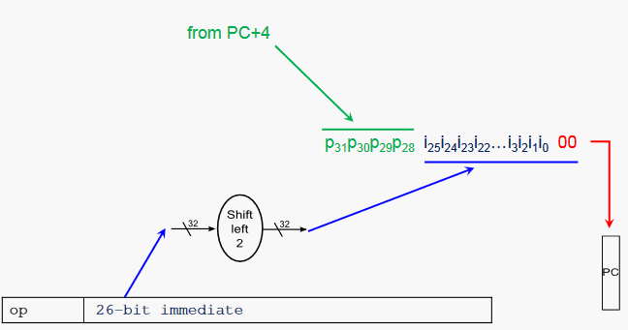
31
0
6
26

Slide 86
J-Format Instructions
Jump instruction:
New PC = { (PC+4)[31..28], target address, 0b00 }
Notes:
{ , , } means concatenation { 4 bits , 26 bits , 2 bits } = 32 bit address
Array indexing: [31..28] means highest 4 bits
For hardware reasons, use PC+4 instead of PC

Slide 87
Summary
The Stored Program concept is very powerful
Instructions can be treated and manipulated the same way as data in both hardware and software
MIPS Machine Language Instructions:
Branches use PC-relative addressing, Jumps use absolute addressing
R:
opcode
rs
rt
rd
shamt
funct
I:
opcode
rs
rt
immediate
J:
opcode
target address

Slide 88
Assembly Practice
Assembly is the process of converting assembly instructions into machine code
On the following slides, there are 6-lines of assembly code, along with space for the machine code
For each instruction,
Identify the instruction type (R/I/J)
Break the space into the proper fields
Write field values in decimal
Convert fields to binary
Write out the machine code in hex
Use your Green Sheet; answers follow

Slide 89
Code Questions
Addr Instruction
800 Loop: sll $t1,$s3,2
804 addu $t1,$t1,$s6
808 lw $t0,0($t1)
812 beq $t0,$s5, Exit
816 addiu $s3,$s3,1
820 j Loop
Exit:
Material from past lectures:
What type of C variable is probably stored in $s6?
Write an equivalent C loop using a→$s3, b→$s5, c→$s6. Define variable types (assume they are initialized somewhere) and feel free to introduce other variables as you like.
In English, what does this loop do?

Slide 90
Code Questions
Addr Instruction
800 Loop: sll $t1,$s3,2
804 addu $t1,$t1,$s6
808 lw $t0,0($t1)
812 beq $t0,$s5, Exit
816 addiu $s3,$s3,1
820 j Loop
Exit:
Material from past lectures:
What type of C variable is probably stored in $s6?
int * (or any pointer)
Write an equivalent C loop using a→$s3, b→$s5, c→$s6. Define variable types (assume they are initialized somewhere) and feel free to introduce other variables as you like.
int a,b,*c;
/* values initialized */
while(c[a] != b) a++;
In English, what does this loop do?
Finds an entry in array c that matches b.

Slide 91
Assembly Practice Question
Addr Instruction
800 Loop: sll $t1,$s3,2
804 addu $t1,$t1,$s6
808 lw $t0,0($t1)
812 beq $t0,$s5, Exit
816 addiu $s3,$s3,1
820 j Loop
Exit:
__:
__:
__:
__:
__:
__:

Slide 92
Assembly Practice Answer (1/4)
Addr Instruction
800 Loop: sll $t1,$s3,2
804 addu $t1,$t1,$s6
808 lw $t0,0($t1)
812 beq $t0,$s5, Exit
816 addiu $s3,$s3,1
820 j Loop
Exit:
R:
opcode
rs
rt
rd
shamt
funct
R:
opcode
rs
rt
rd
shamt
funct
I:
opcode
rs
rt
immediate
I:
opcode
rs
rt
immediate
I:
opcode
rs
rt
immediate
J:
opcode
target address

Slide 93
Assembly Practice Answer (2/4)
Addr Instruction
800 Loop: sll $t1,$s3,2
804 addu $t1,$t1,$s6
808 lw $t0,0($t1)
812 beq $t0,$s5, Exit
816 addiu $s3,$s3,1
820 j Loop
Exit:
R:
0
0
19
9
2
0
R:
0
9
22
9
0
33
I:
35
9
8
0
I:
4
8
21
2
I:
8
19
19
1
J:
2
200

Slide 94
Assembly Practice Answer (3/4)
Addr Instruction
800 Loop: sll $t1,$s3,2
804 addu $t1,$t1,$s6
808 lw $t0,0($t1)
812 beq $t0,$s5, Exit
816 addiu $s3,$s3,1
820 j Loop
Exit:
R:
000000
00000
10011
01001
00010
000000
R:
000000
01001
10110
01001
00000
100001
I:
100011
01001
01000
0000 0000 0000 0000
I:
000100
01000
10101
0000 0000 0000 0010
I:
001000
10011
10011
0000 0000 0000 0001
J:
000010
00 0000 0000 0000 0000 1100 1000

Slide 95
Assembly Practice Answer
Addr Instruction
800 Loop: sll $t1,$s3,2
0x 0013 4880
804 addu $t1,$t1,$s6
0x 0136 4821
808 lw $t0,0($t1)
0x 8D28 0000
812 beq $t0,$s5, Exit
0x 1115 0002
816 addiu $s3,$s3,1
0x 2273 0001
820 j Loop
0x 0800 00C8
Exit:
R:
R:
I:
I:
I:
J:

Slide 96
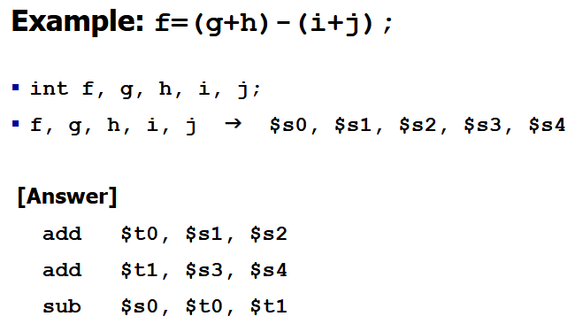

Slide 97
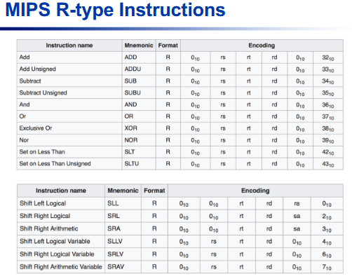

Slide 98
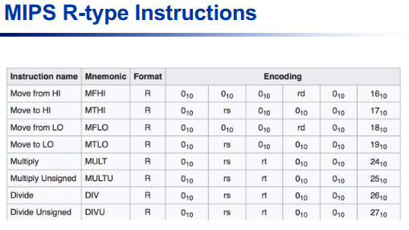

Slide 99
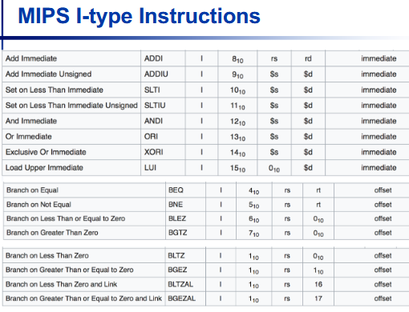

Slide 100
